Slide 1

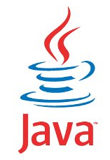
JAVA SE
(Core java)
Lecture 2

Slide 2

Today’s Agenda
Moving Ahead with JAVA
History Of Java
Editions Of Java
Difference Between JDK,JRE and JVM
Downloading JDK
Installing JDK
Verifying The Installation

Slide 3

History Of Java
Developed By: James Gosling
Original Company Name: Sun Microsystems
Current Company: Oracle Corp
Original Name: Oak but due to copyright issues , changed to Java
First release: 23rd January 1996
First version: JDK(Java Development kit) 1.0
Latest version : JDK(19.0) released on 20 Sep 2022
James Gosling

Slide 4
Editions/Flavours Of Java
When Java was originally released in 1996, it was just Java and no such thing as “editions” was there.
But as use of Java increased , then in 1999 , SUN categorized it into 3 editions called J2SE,J2EE and J2ME .
Later on in 2006 they changed the naming and called them as JSE,JEE and JME.
These editions were named based on the kind of application which can be developed by learning that edition.

Slide 5
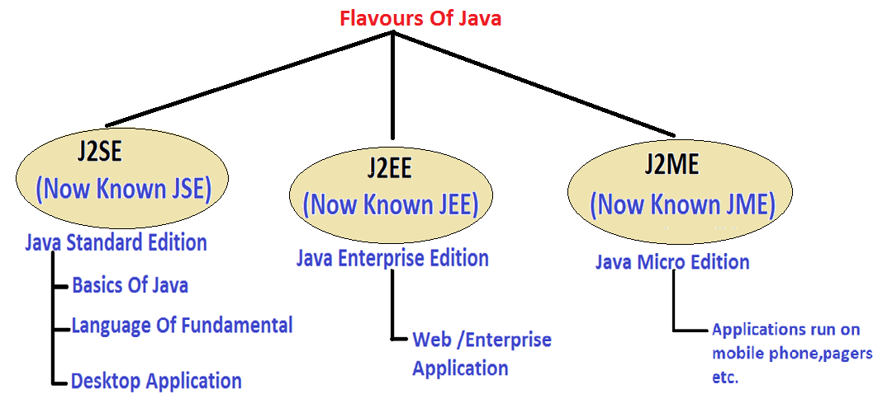
Java Editions

Slide 6
JSE(Java Standard Edition)
This is the most basic version of Java and it provides us core concepts of Java language like the data types , operators, arrays, methods , OOP , GUI (Graphical User Interface ) etc.
Since it teaches us core concepts of Java that is why many people call it CORE JAVA , although SUN never gave this name.
Used for developing desktop applications like calculators, media player, IDE etc

Slide 7
JEE(Jakarta Enterprise Edition)
Originally called Java Enterprise Edition but from 2017 it was renamed to Jakarta Enterprise Edition
JEE is built on top of the Java SE platform and is a collection of libraries used for building "enterprise applications" (usually web applications).
In simple terms we can say JEE is used for developing applications which run on servers.
Some popular applications developed using JEE are amazon.in, alibaba.com, linkedin.com, myvi.in, support.apple.com etc

Slide 8
JME(Java Micro Edition)
Java ME is the slimmer version of Java targeted towards small devices such as mobile phones.
Generally people tend to think of the micro edition as the mobile edition, while in reality, the micro edition is used not just for mobile phones, but for all kinds of devices, such as television sets, printers, smartcards and more.
But as smartphone technology arrived the use of JME has reduced as Android has superseded it.

Slide 9
JDK v/s JRE v/s JVM
Understanding the difference between JDK,JRE and JVM is very very important in Java for interviews
These terms stand for:
JDK: Java Development kit
JRE: Java Runtime Environment
JVM: Java Virtual Machine

Slide 10
What Is JVM ?
JVM is an abstract machine that can be used to run Java programs.
In simple terms it is the code execution component of java
It is designed for each platform(OS+CPU) supported by Java and this means that every platform will have a different version of JVM

Slide 11
QUIZ
What does the JVM(Java Virtual Machine) do?
Compiles the Java Source Code
Generates bytecode
Converts bytecode to underlying machine’s instruction set.
Checks for error

Slide 12
QUIZ
The JVM for every platform is different
True
False

Slide 13
QUIZ
The bytecode generated by Java compiler for the same code for every platform is different
True
False

Slide 14
QUIZ
Why JVM is called a virtual machine ?
JVM is called virtual machine because it is a software layer but it
behaves as if it is a complete machine(platform).
That is all the tasks which are done by a machine while running a
program in other languages like C , are actually done by JVM in Java .
For example:
Starting The Execution By Calling main( )
Allocating Memory For The Program
Cleaning Up Memory cleanup etc

Slide 15
What JVM Contains?
JVM contains following important components
Interpreter
Garbage Collector

Slide 16
QUIZ
Are java compiler and interpreter same?
No , not at all.
The Java compiler converts source code to bytecode and is not a
part of JVM , rather it comes with JDK.
The interpreter lives inside the JVM and converts bytecode to
Machine understandable form

Slide 17
What Is JRE ?
JRE is an acronym for Java Runtime Environment
It contains a JVM along with java classes/packages and set of runtime libraries.
So the JVM , while running a java program uses the classes and other libraries supplied by JRE.
If we do not want to write a java program , and we just want to run it then we only need a JRE
Notes:
time

Slide 18
What Is JDK ?
JDK stands for Java Development Kit and is a bundle of software that we can use to develop Java based applications.
It includes the JRE, set of library classes, Java compiler, jar and additional tools needed while developing a Java application.
Notes:
time

Slide 19
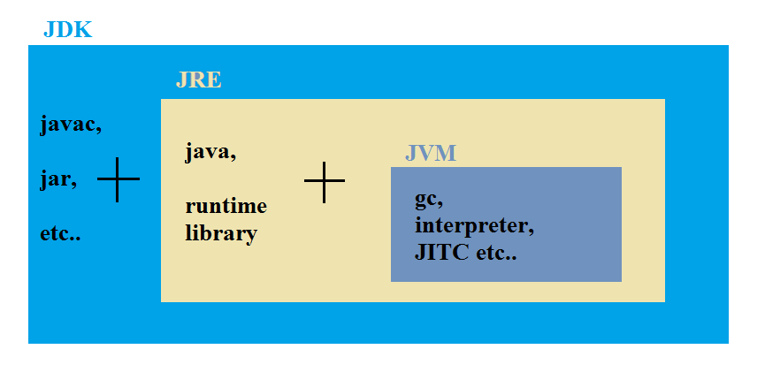
JDK,JRE and JVM
Notes:
time

Slide 20
QUIZ
Can I compile a java application if I have a JRE ?
Yes
No
Correct Answer: No
JRE can only be used to run a Java application . It doesn’t contain the javac tool which is used for compilation

Slide 21
QUIZ
Which component is used to compile, debug and execute java program?
A) JVM
B) JDK
C) JIT
D) JRE
Correct Answer: B

Slide 22
QUIZ
Which component is used to convert bytecode to machine specific code ?
A) JVM
B) JDK
C) JIT
D) JRE
Correct Answer: A

Slide 23
QUIZ
Which component is used to provide a platform to run a java program ?
A) JVM
B) JDK
C) JIT
D) JRE
Correct Answer: D

Slide 24
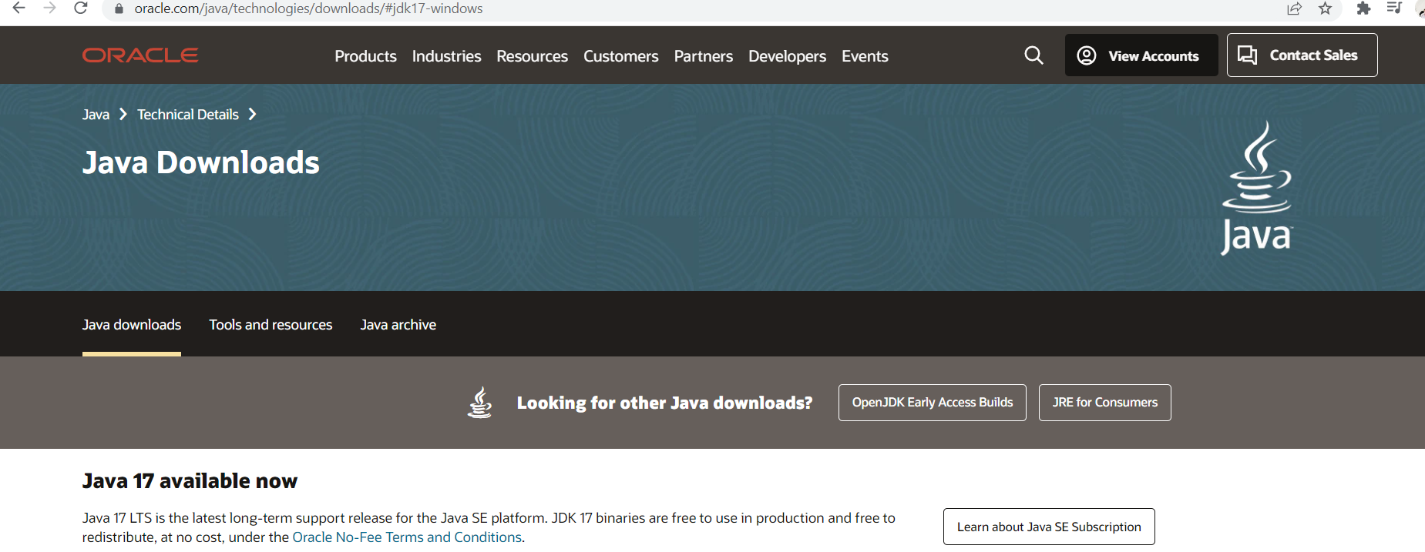
Downloading JDK
STEP 1: Go to
https://www.oracle.com/java/technologies/downloads/

Slide 25
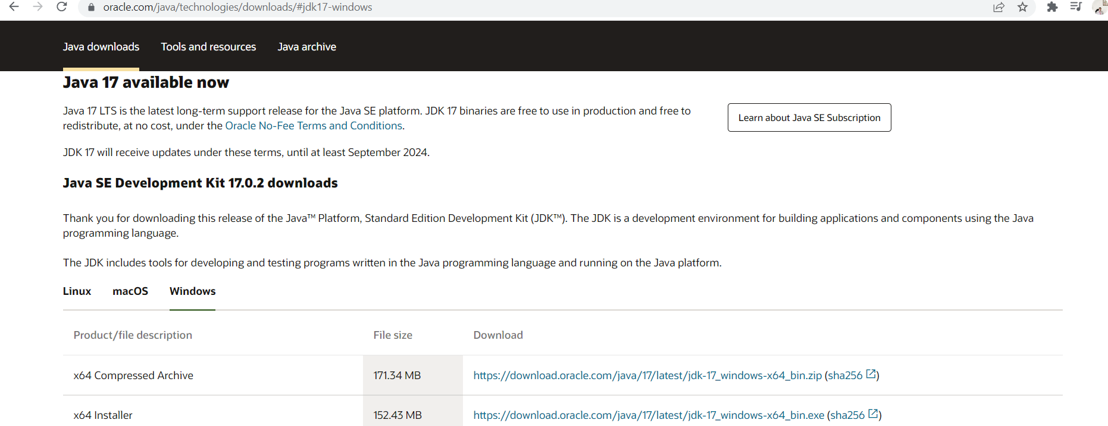
Downloading JDK
STEP 2: Click on the tab of your OS and click on x-64 installer

Slide 26
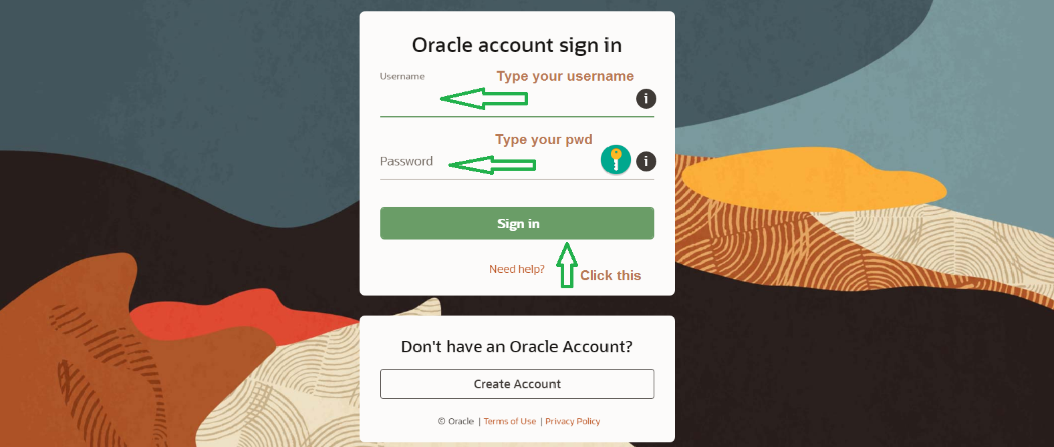
Downloading JDK
STEP 3: You will be asked to login. So login to your Oracle account

Slide 27
Installing JDK
The download will begin .
When the download completes, you will get an exe file called jdk-17.0.02_windows-x64_bin.exe
Now, right click on this exe file and "Run as Administrator".
An installer window will pop up.

Slide 28
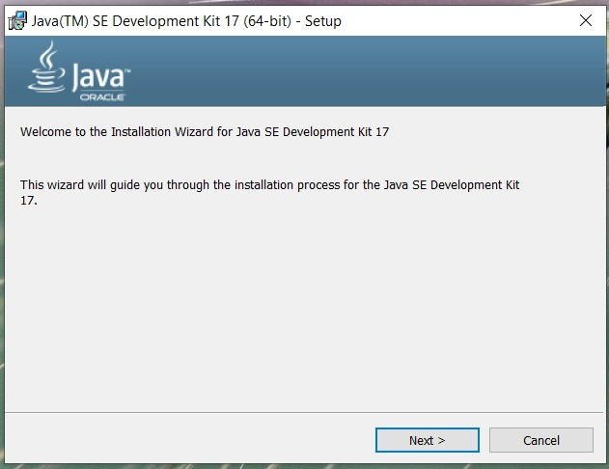
Installing JDK

Slide 29
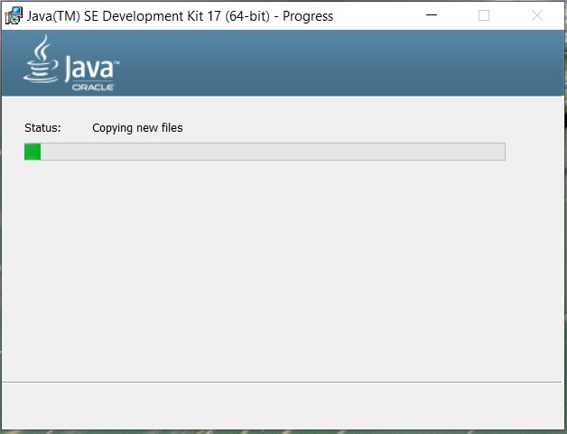
Installing JDK

Slide 30
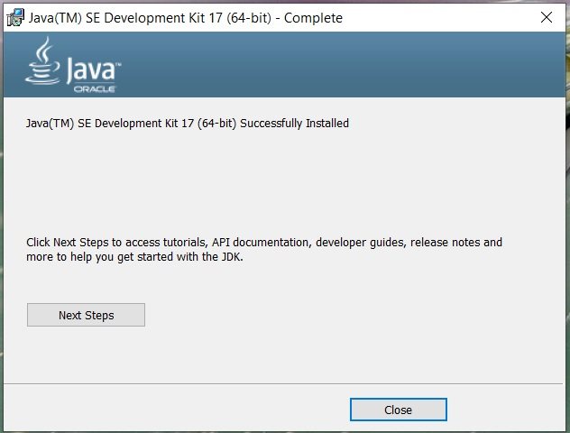
Installing JDK
If everything goes perfectly you will receive a message saying that installation is successful.

Slide 31
Verifying Installation
Go to the specified path, where you install your Java.
By default Java gets installed in C:\Program Files folder
There you will see a Java folder
Inside the Java folder you will see jdk-17.0.2 folder

Slide 32
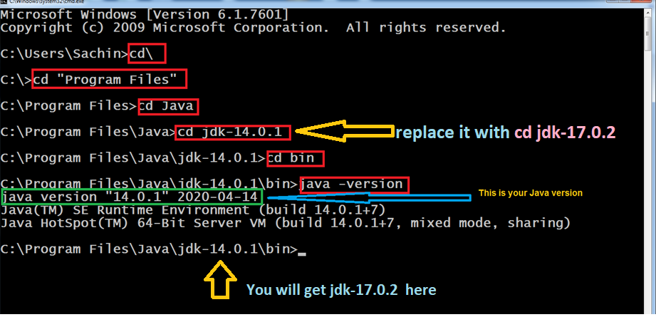
Verifying Installation
Go to start type cmd and open it by clicking on it and type the following command highlighted in red:

Slide 33
LTS And STS
The last 4 years have seen some rapid changes in the way new versions of the Java Development Kit is deployed and maintained.
Traditionally, new Java versions were always released in a 2 to 4 year life cycle.
Every 2 to 4 years, a new JDK would be released, containing some new features .

Slide 34
LTS And STS
JDK Release Tmeline
– JDK 6: launched in Dec,2006
– JDK 7: launched in July , 2011
– JDK 8: launched in Mar,2014
– JDK 9: launched in Sep, 2017

Slide 35
LTS And STS
But from Java 10 ,which was released in March 2018, Oracle changed the new release policy and decided to launch a new version of Java every 6 months.
Now , it became very difficult for Software Developers to keep their applications or several hundred (thousand?) servers up to date with the newest Java release.
That is why , the concept of an LTS was established.

Slide 36
LTS And STS
A Java LTS (long-term support) release is a version of Java that will remain the industry standard for several years.
To give an example of this, Java 8 was released in 2014, it will continue to receive updates until 2022, and extended support will end by 2030.
This gives plenty of time to application developers to update their applications to take full advantage of Java 8 features.
https://www.oracle.com/java/technologies/java-se-support-roadmap.html

Slide 37
LTS And STS
The next LTS version is Java 11, which was released in 2018 and will continue to receive updates until 2026, with a strong possibility of date extension
The next 4 releases of Java, after Java 11, which are Java 12 , Java 13 , Java 14 & Java 15 are all STS ( Short Term Support)
JDK 17, which has released in September 2021, is the latest LTS release and will be supported as long as Sep 2029 with a strong possibility of date extension

Slide 38

End Of Lecture 2
For any queries mail us @: scalive4u@gmail.com
Call us @ : 0755-4271659, 9826686245
Agenda for Third Lecture:
Different Ways Of Writing A Java Code
Writing First Java Code Using Notepad
Different Elements In The Code
Explanation Of Each Element

